Slide 1
Machine Learning Models: a hands-on experience
UniCredit Quant Community
Gabriele Bonomi Boseggia, Fabio Colombo, Luca Mammi
Milan, May 8th, 2018

Slide 2





Why do we need Machine Learning?
Every decisional process we observe is the outcome of a judgmental process
Sometimes it is useful to automatize such processes, to support human decision
Take an umbrella while leaving for work
Ok, maybe not!
€
Grant a loan to someone
Grant loans to 1 million candidates
Apply a commercial offer to a client
Associate similar offers to similar clients
Extract the main message of written text
Identify spam
Identify contents of a picture
Identify diseases in a million CAT scans

Slide 3
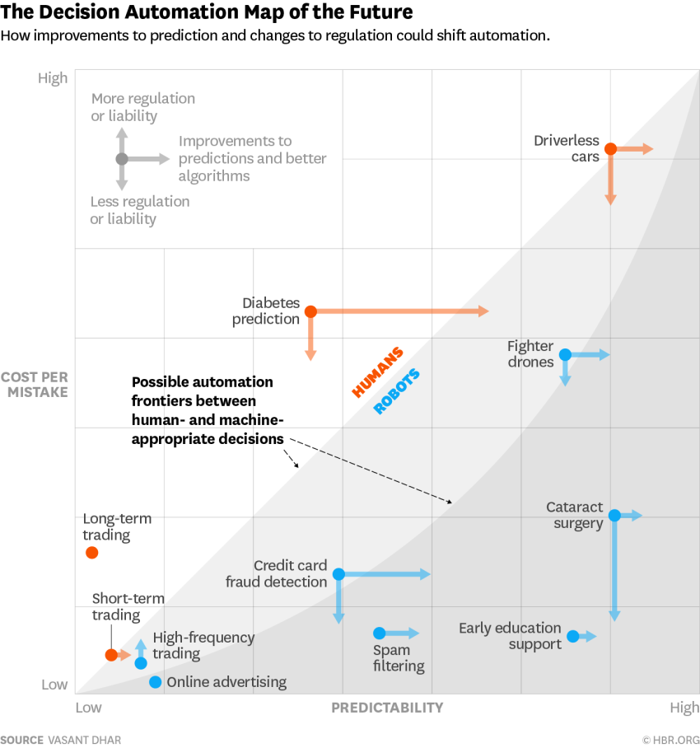
What is Machine Learning used for?
https://hbr.org/2016/05/when-to-trust-robots-with-decisions-and-when-not-to

Slide 4
What is Machine Learning?
Machine Learning is a set of tools that use information to enable the automation of decision making
Training Data
Machine Learning Algorithm
New Data
Trained Model
Prediction
Prescriptive Analytics
Machine learning
Decision making

Slide 5
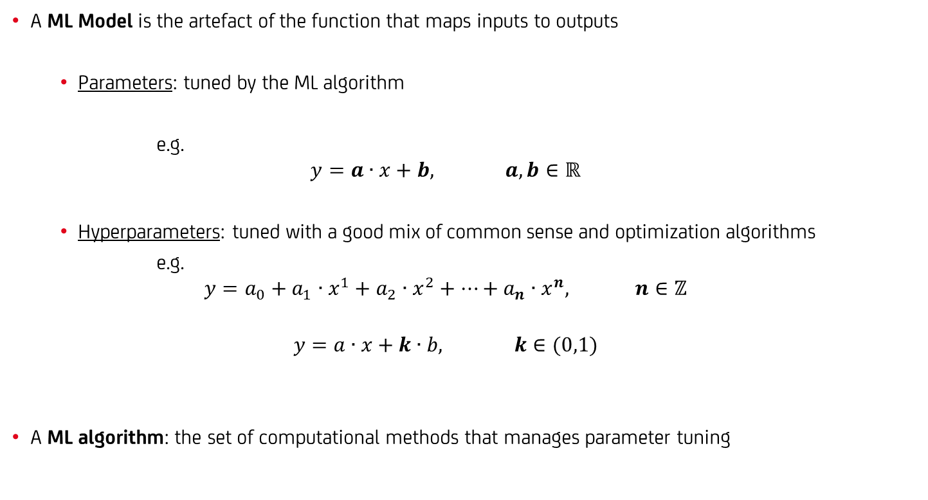
What is Machine Learning?
A ML Model is the artefact of the function that maps inputs to outputs
Parameters: tuned by the ML algorithm
e.g.
$$y=a∙x+b, a,b∈ℝ$$
Hyperparameters: tuned with a good mix of common sense and optimization algorithms
e.g.
$$y=a_{0}+a_{1}∙x^{1}+a_{2}∙x^{2}+…+a_{n}∙x^{n}, n∈ℤ$$
$$y=a∙x+k∙b, k∈(0,1)$$
A ML algorithm: the set of computational methods that manages parameter tuning

Slide 6
Types of Machine Learning – by how they work
Labelled data
Unlabelled data
Environment model
Supervised learning
Unsupervised learning
Reinforcement learning
Classification
Clustering
Regression
Dimensionality reduction
…but is this the most
effective taxonomy?

Slide 7
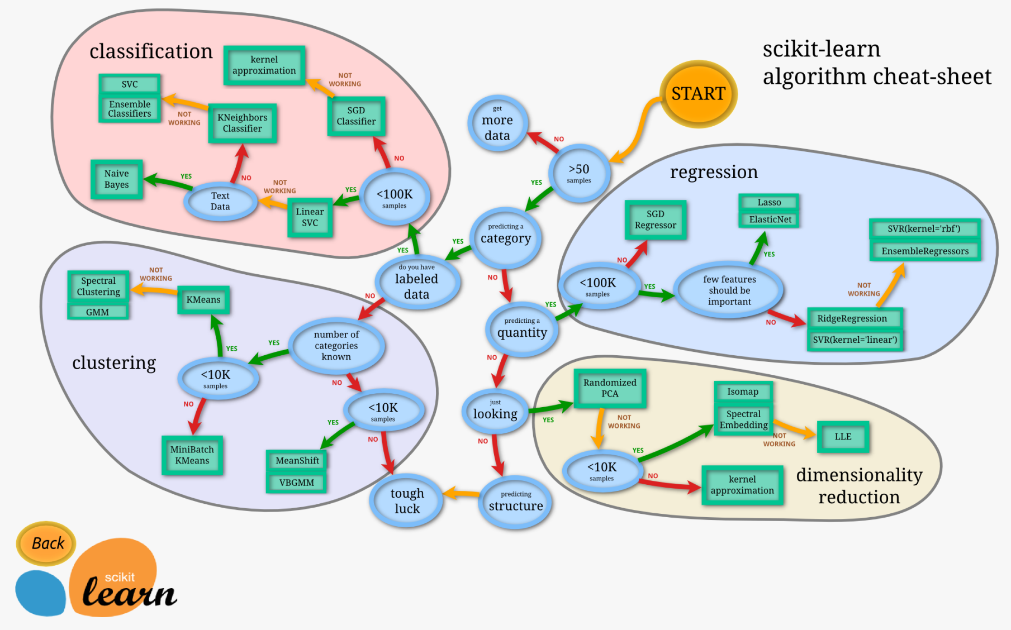
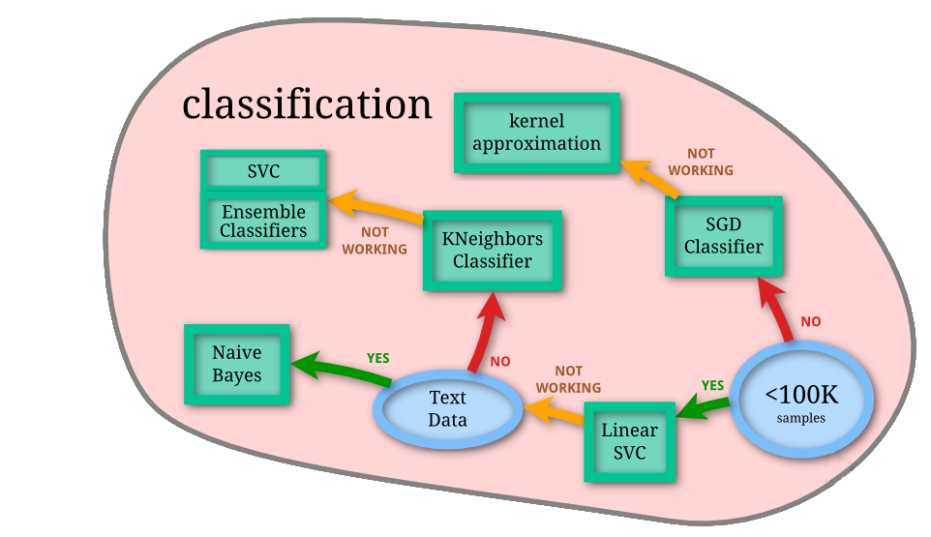
Types of Machine Learning – by what we need them to do
we will focus on classification
http://scikit-learn.org/stable/tutorial/machine_learning_map/index.html

Slide 8


What do you need for Machine Learning?
Questa slide è solo uno scheletro
You just need the right R packages!
tidyverse (developed by Hadley Wickham, Chief Scientist at Rstudio)
"a set of packages that work in harmony because they share common data representations and API design"
including dplyr, ggplot2, magrittr
caret (Classification And REgression Training)
"a set of functions that attempt to streamline the process for creating predictive models"
calls packages such as e1071, keras, mlbench, randomForest
https://cran.r-project.org/package=tidyverse, Wickham, Hadley (2017). "R for data science"
https://cran.r-project.org/package=caret

Slide 9
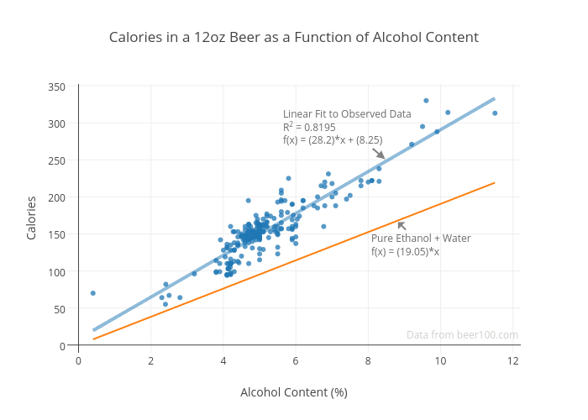
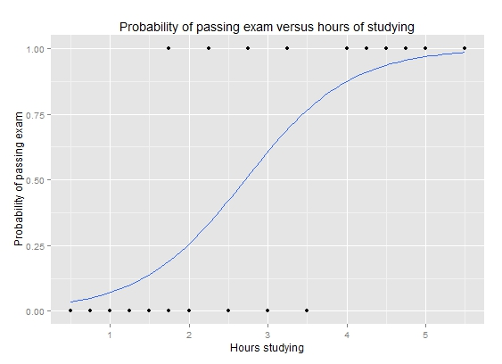
Machine learning models
Linear Regression
to predict a score
Logistic Regression
to predict a probability

Slide 10
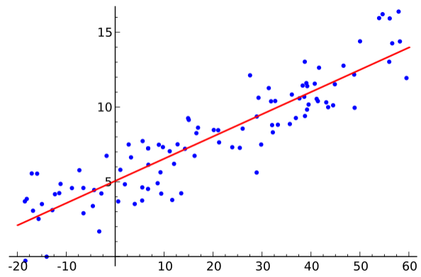
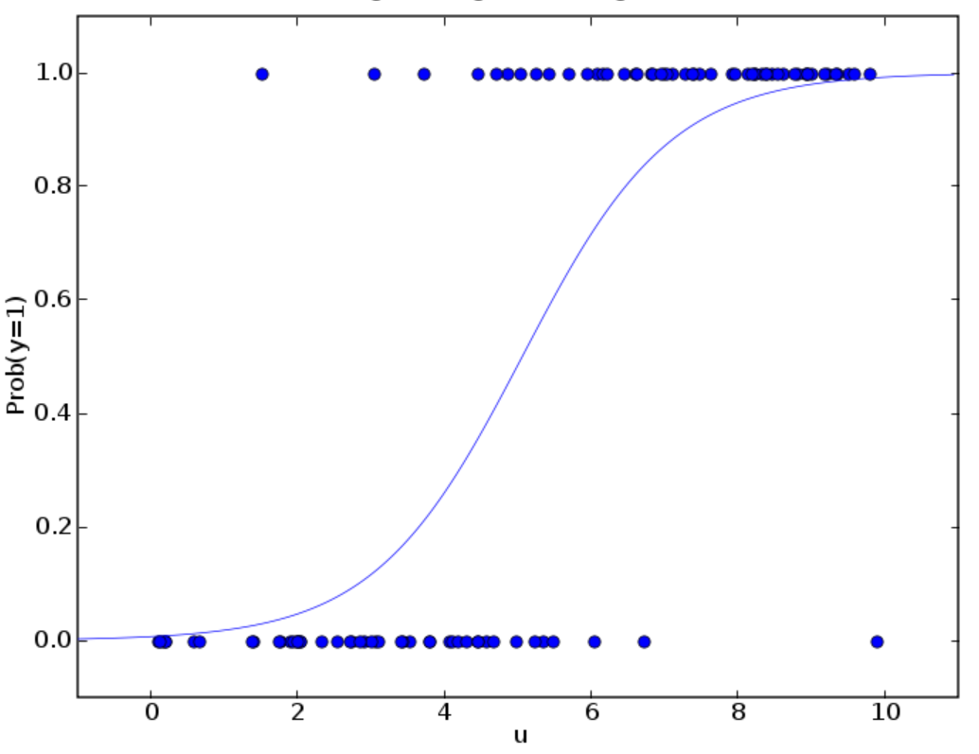
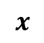

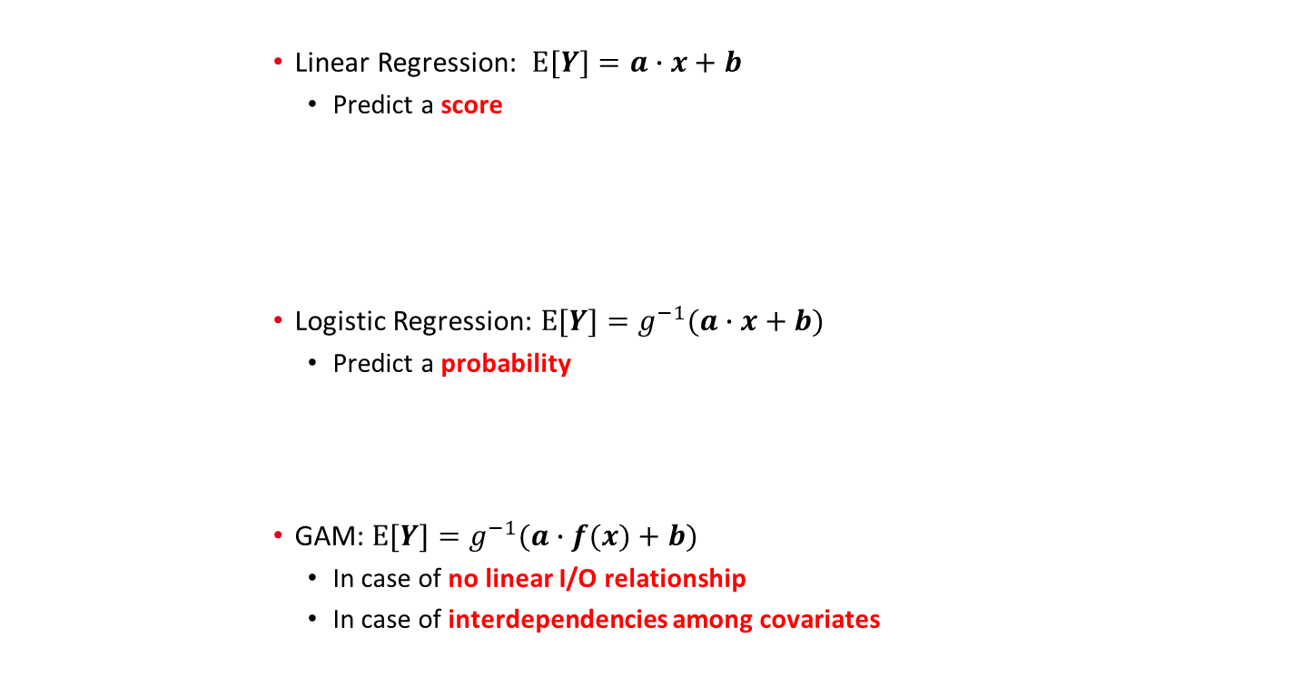

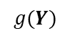
Machine Learning: a helicopter view
Still to be completed, this is not enough clear in my opinion. Need to find an effective way to do it.
Maybe it is worth including the algorithm that does the job
$$Y$$
Linear Regression: $E[Y]=a∙x+b$
Predict a score
Logistic Regression: $E[Y]=g^{−1}(a∙x+b)$
Predict a probability
GAM: $E[Y]=g^{−1}(a∙f(x)+b)$
In case of no linear I/O relationship
In case of interdependencies among covariates
Linear Model
Response Variable
Covariates vector (predictor variables)
Normally distributed errors
$$x$$
Link function
$$g(Y)$$
Generalized Linear Model
Binary Response Variable
Smooth function
Generalized Additive Model
$$Y$$
http://www.utstat.toronto.edu/~brunner/oldclass/2201s11/readings/glmbook.pdf
https://projecteuclid.org/download/pdf_1/euclid.ss/1177013604

Slide 11
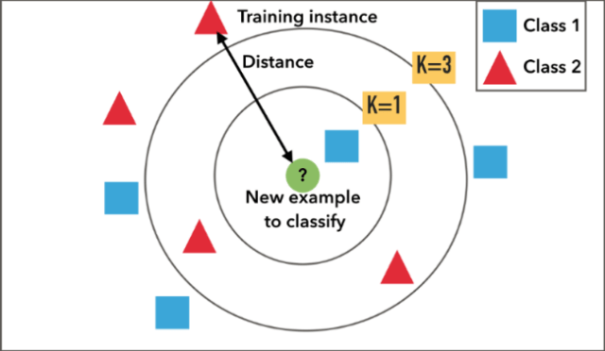
Machine Learning: a helicopter view
Questa slide è solo uno scheletro
A conceptually simple algorithm: if you want to classify a new item, look at its neighbors!
How many neighbors? Obviously K!
Which neighbors are the nearest ones? Euclidean distance, hamming distance, correlation…
What if the k nearest neighbors belong to different classes:
Tiranny of the majority.
Weighted by distance: kernel & links with non parametric models.

Slide 12
Machine Learning: a helicopter view
Questa slide è solo uno scheletro
Fabio's choice

Slide 13
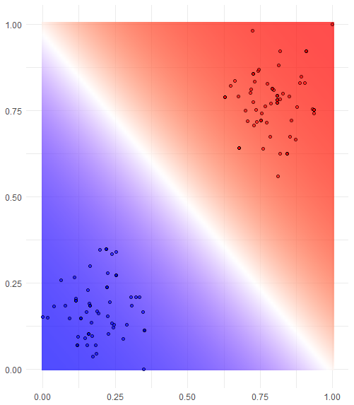
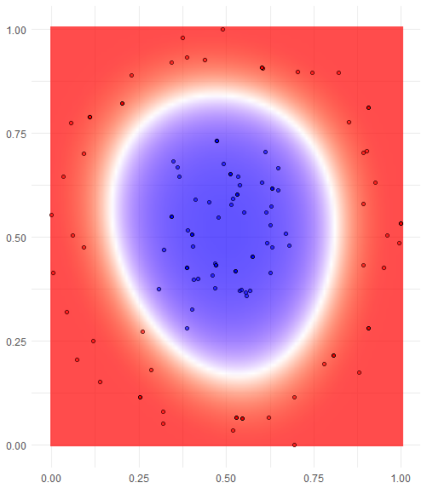
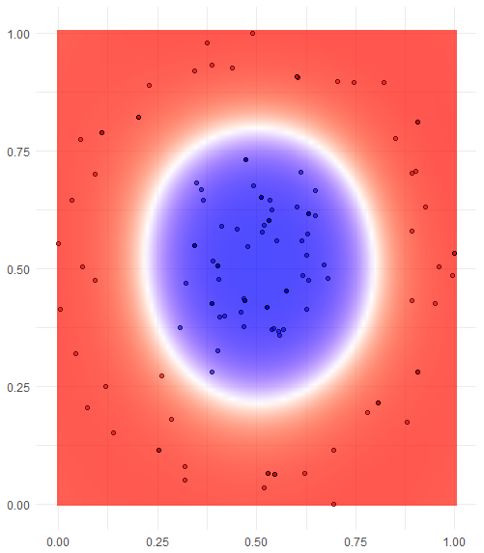
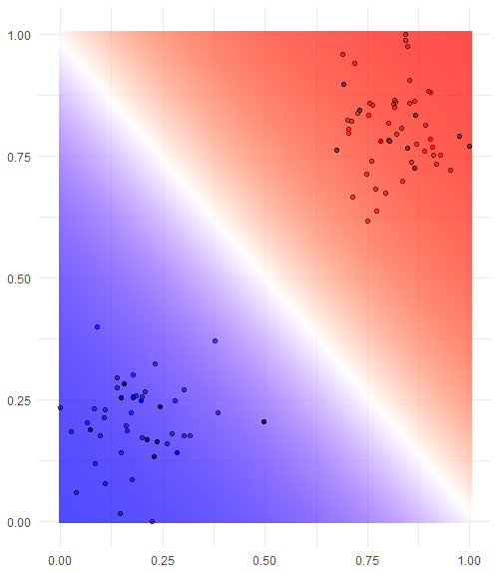
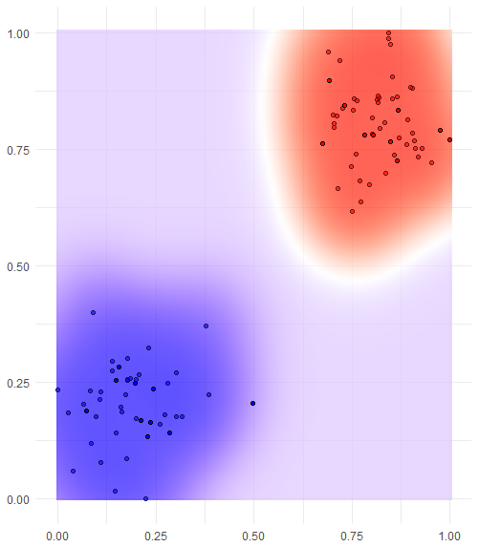
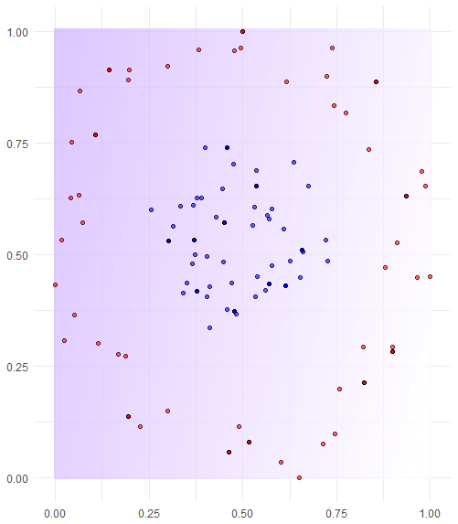
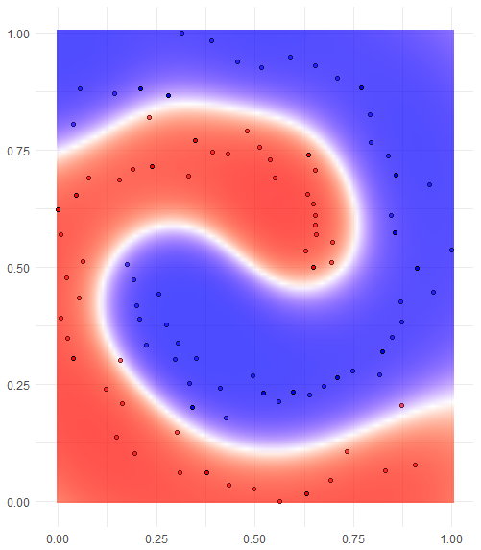
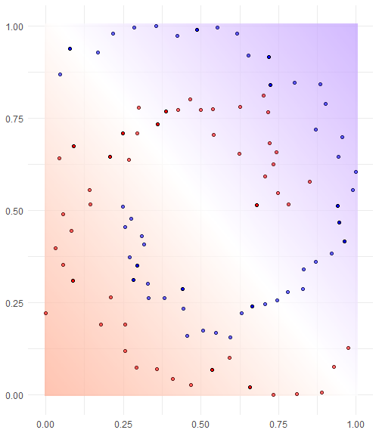
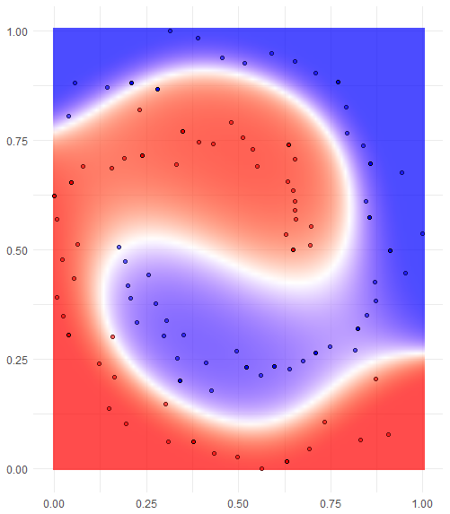
Machine Learning: a helicopter view
Questa slide è solo uno scheletro
Support Vector Machine (SVM)
Find the best class-separating hyperplane in a n-dimensional kernel space
It can be shown that equation of the hyperplane is solely determined by the support vectors, i.e. the points the closest to such hyperplane
Some formulas?
Linear Kernel
Polynomial Kernel
Radial Kernel
Perhaps insert the tuning hyperparameters here

Slide 14
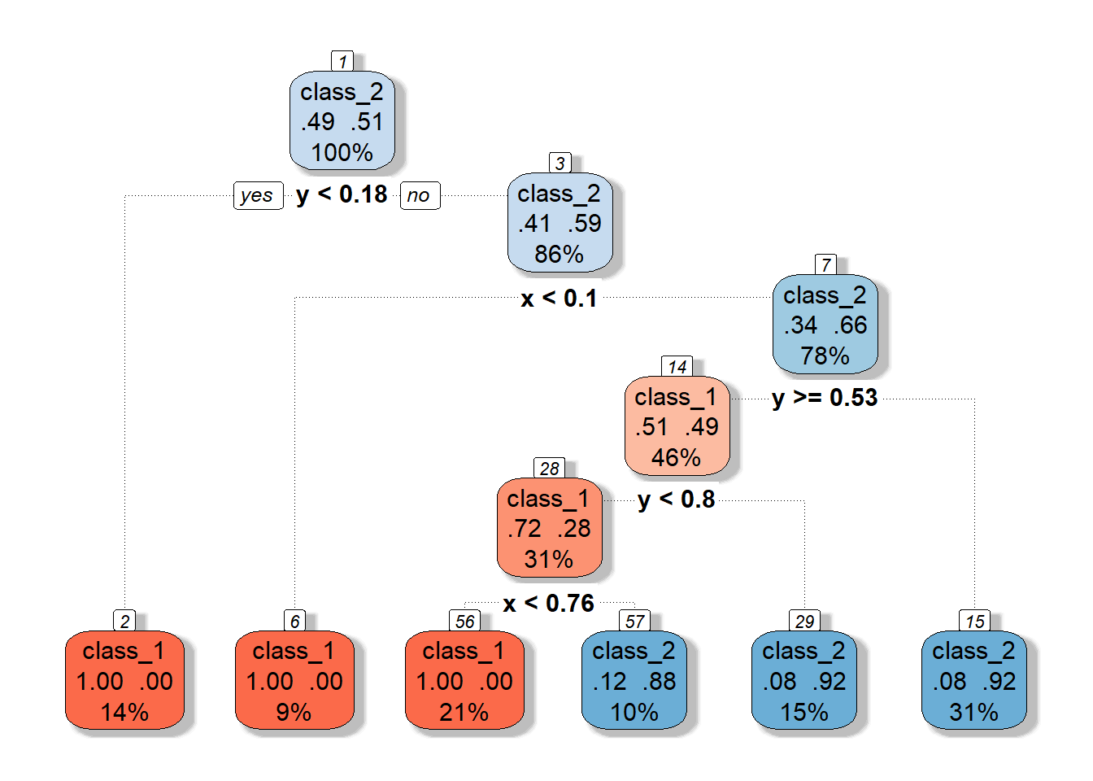
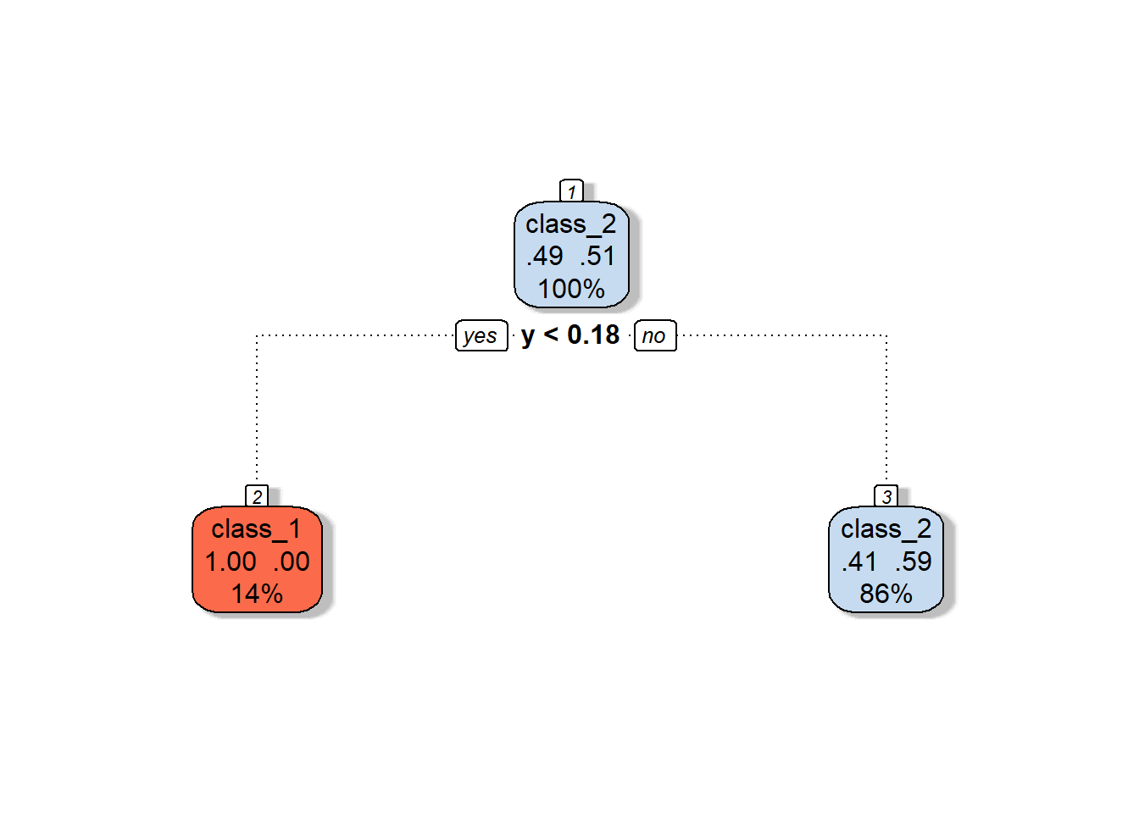
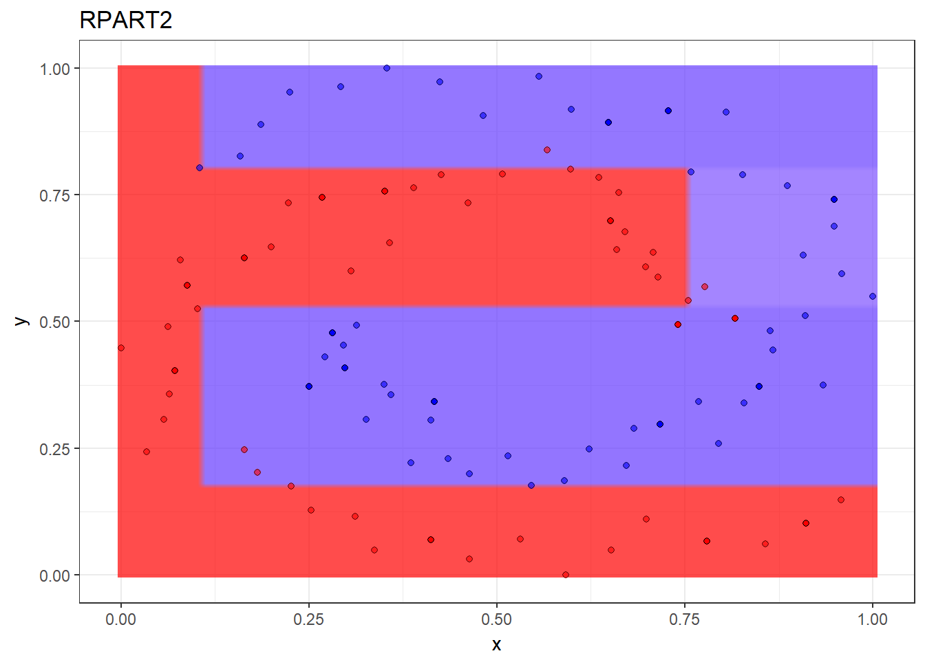
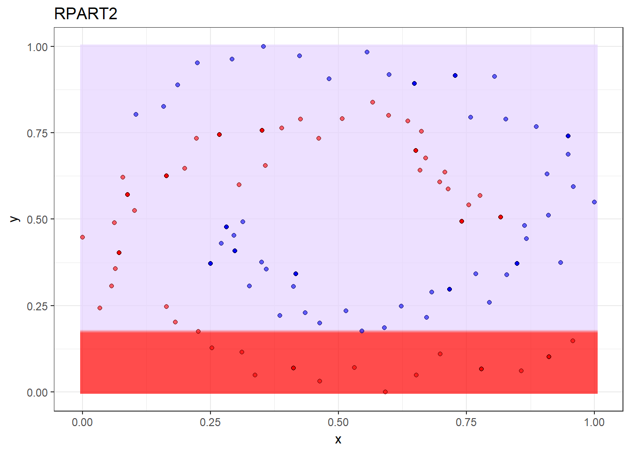
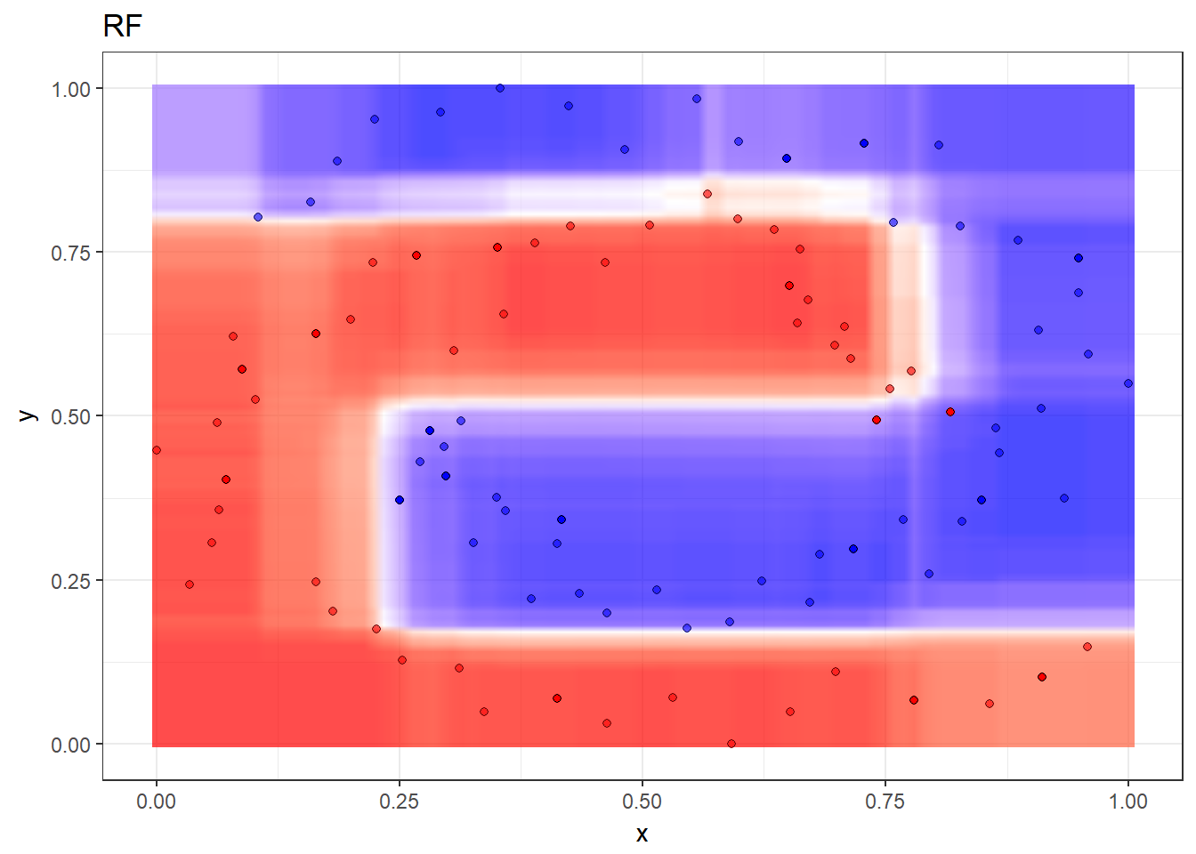
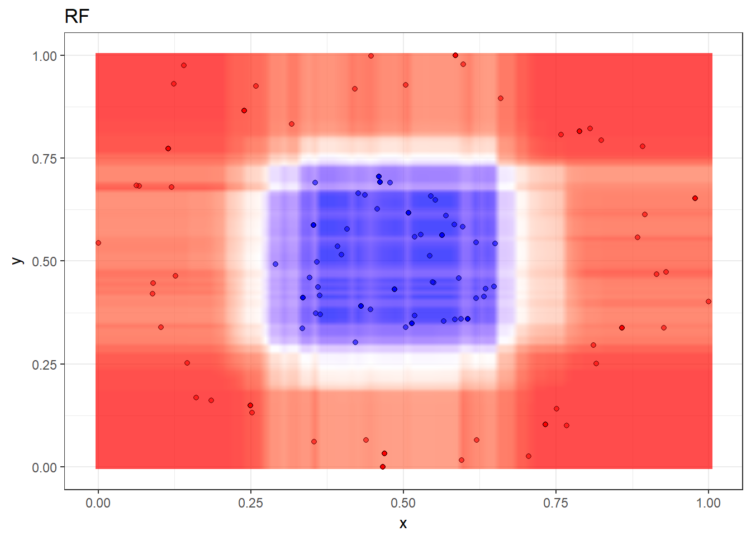
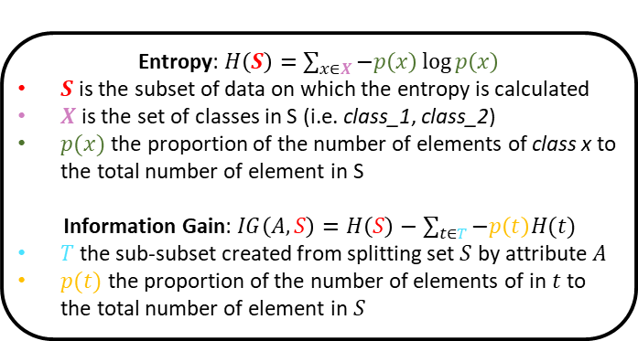
Machine Learning: a helicopter view
Decision Trees
Classification (or regression) models in the form of a tree structure. The algorithm, ID3* iteratively breaks down a dataset into smaller subsets. Each time, the split is performed on the feature that maximize the information gain (i.e. entropy reduction).
Random Forest
The algorithm builds multiple decision trees on a random subset of features and weights the predicted outcomes together to get a more accurate and stable prediction.
Entropy: $H\left(S\right)=\sum_{x∈X}{−p\left(x\right)\log{p\left(x\right)}}$
$S$ is the subset of data on which the entropy is calculated
$X$ is the set of classes in S (i.e. class_1, class_2)
$p(x)$the proportion of the number of elements of class x to the total number of element in S
Information Gain: $IG\left(A,S\right)=H\left(S\right)−\sum_{t∈T}{−p\left(t\right)H(t)}$
$T$ the sub-subset created from splitting set $S$ by attribute $A$
$p(t)$ the proportion of the number of elements of in $t$ to the total number of element in $S$
Isn’t that too much?
* Iterative Dichotomizer http://hunch.net/~coms-4771/quinlan.pdf

Slide 15
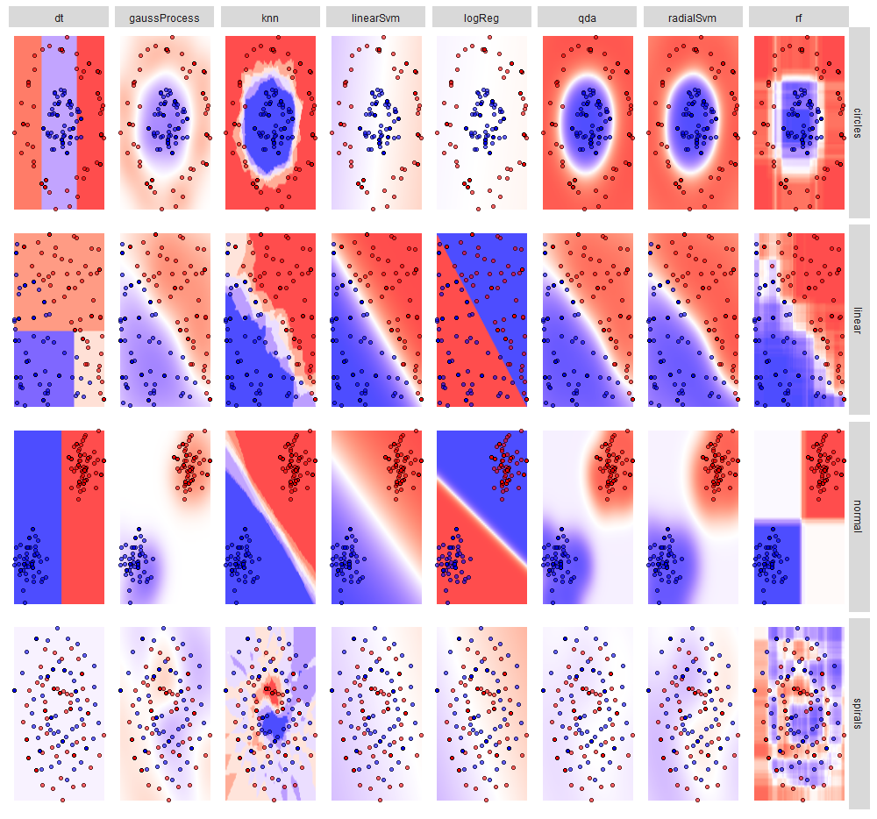
Machine Learning: model comparison
Da aggiornare con l'ultima versione
…but how do we choose the best model?

Slide 16

Visualization: always recommended (when possible)
know your data!
https://www.autodeskresearch.com/publications/samestats

Slide 17
Machine Learning: model evaluation and selection
How do we choose the best model?
p-values
stepwise variable selection
AIC
BIC
…
sure, visualization can help, but it often difficult and never enough
and what about overfitting?
tune in next time!
focus on the task

Slide 18
Machine Learning is nothing new, why the hype?
A.M. Legendre: least squares method
Google Brain: NN to recognize cats in videos
IBM: programs that play checkers
Facebook: DeepFace to recognize faces
F. Rosenblatt: the perceptron
Google: Sibyl to predict user behavior
T. Cover, P. Hart: k-NN
Google: AlphaGo beats humans at Go
S. Linnainmaa: automatic differentiation
Stanford University: a cart that can navigate and avoid obstacles in a room
K. Fukushima - the neocognitron
D. Rumelhart, G. Hinton, R.J. Williams: backpropagation
C. Watkins - Q-learning for reinforcement learning
G. Tesauro: machine playing backgammon
T.K. Ho: random decision forests
C. Cortes, V. Vapnik: SVM
S. Hochreiter, J. Schmidhuber: LSTM for recurrent NNs
IBM: machine beats chess world champion Kasparov
Netflix Prize competition launched (won in 2009)
IBM: programs that play checkers
Kaggle is born
G. Hinton: capsule networks
1805
1952
1957
1967
1970
1979
1980
1986
1989
1992
1995
1997
2006
2010
2011
2012
2014
2016
2017
https://en.wikipedia.org/wiki/Timeline_of_machine_learning

